Slide 1
Analysis of marketing strategy of the brand
Napolact in the Romania market
– BIO strategy –

Slide 2
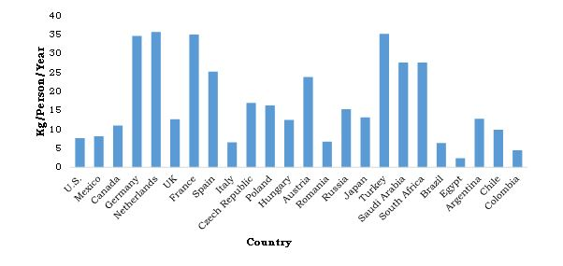
FMCG & Yogurt Market Overview
FMCG & Yogurt Market Overview
Everyone in the world buys and uses fast-moving consumer goods every day. FMCGs account for more than half of all consumer spending, but they tend to be low-involvement purchases - they are the small scale consumer purchase we make. And this is happening because consumers are more into buying a durable good as a smartphone than a chocolate from the convenience store (Kenton, 2019).
As we mantioned above, FMCGs are goods with short life, that are consumed fast and always. And because of the fast moving and the high turnover rate they have, FMCG market is very large and more important, is very competitive. In this case, all FMCGs marketing teams are focused on attracting and engaging cosumers in buying their products.
Yogurt is a product consumed as breakfast, snack, dessert and different other forms. It is prepared by fermentation of pasteurized milk, often flavored and sweetened and it is associated with healthy gut. In 2016, Global Yogurt Market stood at 77.679 million dollars.

Slide 3
The story of Napolact
It seems that the story of Napolact began more than a hundred years ago, under the Vlad’s workshop name. From 1905, when Vlad was selling cheese and butter, in 1948 the factory was nationalized and renamed as „Cluj Milk Industrialization Company” and it started to produce yogurt and melted cheese. From 1990, the factory took the name Napolact and four years later the company was already very appreciatted in Romania, being awarded and becoming in 1998 the first dairy producer in its country. From 2004 Napolact is owned FrieslandCampina Cooperatives. This is the year when Napolact sees the biggest changes and modernizations it has.
Napolact has three factories – two in Cluj and one in Targu Mures County. Even if they imported milk from Hungary, more than 80% is represented by milk produced in Ardeal county – as the company lives under a „traditional” umbrella. Their products portfolio is covering almost all ranges of dairy products – milk, yogurt, cheese, butter, sourcream and Bio products. The ecological certificates which stays under Fieslands’s collaboration and investment, is comming from certified Ardeal farms (FRD Center publication, 2016).
Before Bio investment Napolact was loosing the consumer’s interest. The bio launching was a brand manifesto, managing to determin the growth of Romanians interest in bio products, and gave Napolact his 10% market share from the total Romanian dairy market, but more than 50% in bio.

Slide 4
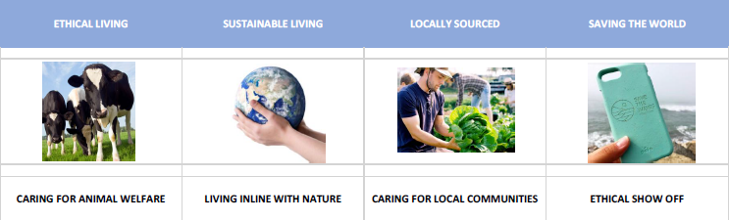

Strategies of targeting
Based on all the info they gathered and the learnings of the market that they had, Napolact launched the Bio range by targeting the following:
Environmentaly conscios tribe of consumers :
Interested in organic milk, clean labe land the local sourcing;
Choose organic because they feel non-organic do harm o the animals and the environment;
Care about the environment and they feel a need to contribute to a better animal welfare;
Bio products are associated with containing less chimicals;
Lacalness is important – contributes to the local society;

Slide 5
Conclusions
Based on all the info we’ve gathered, we present you our conclusions:
Napolact’s products are fast-moving consumer goods, that have managed to take the first position in Romania’s BIO products market.
The company is more than 100 years old, with a 50 years experience in producing yogurt, making it the first dairy producer in it’s country.
More than 80% of their milk comes from certified farms in Ardeal county, wich created their image of a traditional brand.
The company’s experience and involvment in the consumer’s needs has helped them to gain the trust of their customers.
Napolact has identified it’s target, their needs, it’s advantages and it’s obstacles and has created a strategy to help them grow but still maintain their quaility.
The marketing mix is covering all fronts, and is focusing on consumer’s needs and health.
„In tihna” and „#biopebune” platforms educate the customers and helps them to stay connected with the farmers, so they know where their products come from.

